Slide 1
Objectives
  In this lesson, you will learn to:
    Describe characteristics of entity beans
    Identify different types of entity beans
    Explain the life cycle of bean-managed persistence (BMP) entity beans
    Create and deploy bean-managed persistence (BMP) entity beans
    Develop applications using BMP entity beans

Slide 2
Pre-assessment Questions
  At what stage of life cycle, a stateful session bean instance stores client state in secondary storage and stops servicing client requests?
    Ready
    Does not exist
    Passive
    Pooled
  At what stage of life cycle, a stateful session bean instance remains in the shared pool to service client requests?
    Ready
    Pooled
    Passive
    Does not exist

Slide 3
Pre-assessment Questions (Contd.)
  Consider the following statements:
    Statement A: The CMP entity beans enable you to declare the CMP entity bean class as abstract.
    Statement B: The CMP entity beans enable you to declare two abstract methods corresponding a CMP field EJB.
    Which of the above statements is true?
    Statement A is true but Statement B is false
    Statement A is false but Statement B is true
    Both, Statement A and Statement B, are true
    Both, Statement A and Statement B, are false

Slide 4
Pre-assessment Questions (Contd.)
  Who is responsible for serializing the client state of a stateful session bean instance after invoking the ejbPassivate() method?
    Session bean provider
    EJB Server
    Container provider
    EJB container
  Who is responsible for closing all database connections in the stateful session bean ejbPassivate() method and assigning null values to the connection instance variables?
    EJB container provider
    EJB Server
    EJB Container
    Session bean provider

Slide 5
Solutions to Pre-assessment Questions
  c. passive
  a. Ready
  c. Both, Statement A and Statement B, are true
  c. Container provider
  d. Session bean provider

Slide 6
Overview of Entity Beans
  An entity bean:
    Represents persistent data stored in a storage medium, such as a relational database.
    Persists across multiple sessions and can be accessed by multiple clients.
    Acts as intermediary between a client and a database.
    Stores database information temporarily for the client to work on. It then transfers the client-modified information back to the database.

Slide 7
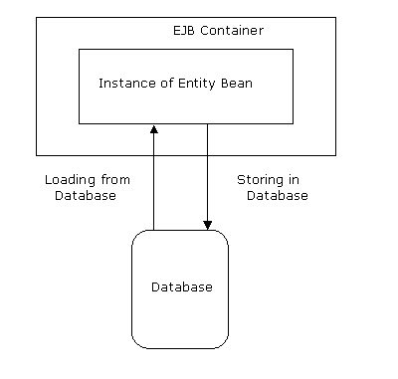
Overview of Entity Beans (Contd.)
  Use of Entity beans
    EJB container creates instances of an entity bean and is responsible for loading data in an instance and storing the information back into the database.
    Loading and Storing of Data:

Slide 8
Overview of Entity Beans (Contd.)
    An instance of an entity bean is a recyclable object. This means that EJB container places instances in an instance pool from where they can be reused as and when necessary to service multiple clients.
    The entity bean instances are assigned to clients randomly. An instance, when assigned to a client, is allocated certain resources.
    EJB container releases the resources allocated to an instance when it is no longer assigned to a client.

Slide 9
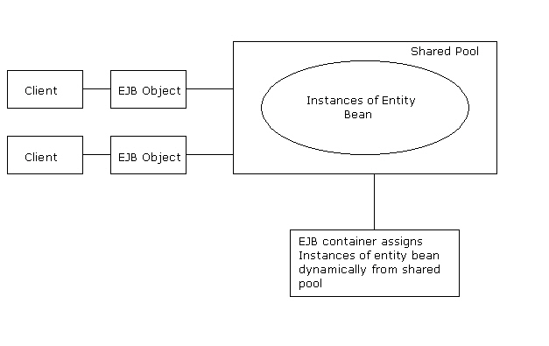
Overview of Entity Beans (Contd.)
    Pooling of Instances of an Entity Bean:

Slide 10
Overview of Entity Beans (Contd.)
  Characteristics of Entity Beans:
    Persistence: An entity bean is persistent in that its state exists even after a client stops accessing an application.
    Shared Access: Multiple clients can share one entity bean by using separate instances of the entity bean.
    Primary Key: Each entity bean has a unique identifier associated with it, known as primary key. A client uses the entity bean’s unique identifier in order to access a specific entity bean for performing operations.

Slide 11
Overview of Entity Beans (Contd.)
  Types of Entity Beans
    Bean-managed persistent (BMP) entity bean: Contains the code to perform operations on the data stored in a database. You can change the code to reflect changes in the database or user requirements.
    Container-managed persistent (CMP) entity bean: Uses EJB container to perform persistence operations. A CMP entity bean is independent of the database.

Slide 12
Bean-Managed Persistence (BMP) Entity Beans
  A BMP entity bean contains the code required for managing persistence of the entity bean.
  Persistence operations include storing, loading, and searching data in a database
  The code for managing the relationships needs to be written at the time of bean development.
  Database access API, such as JDBC and SQL/J can be used for writing the code to manage the persistence.

Slide 13
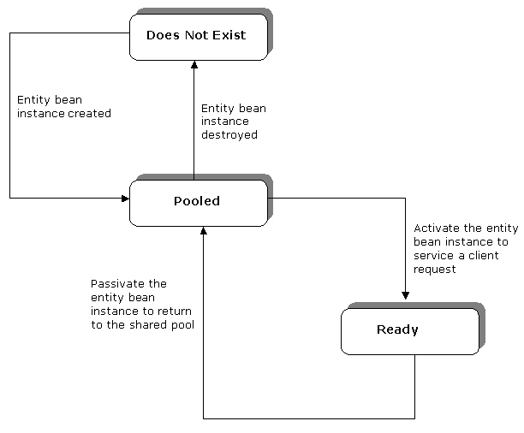
Bean-Managed Persistence (BMP) Entity Beans (Contd.)
  Life cycle of BMP Entity Beans:
    The three stages in the life cycle of a BMP entity bean are:
      Pooled
      Ready
      Does Not Exist

Slide 14
Bean-Managed Persistence (BMP) Entity Beans (Contd.)
    The Pooled Stage
      At the beginning of the life cycle, an entity bean is in the Pooled stage.
      EJB container creates instances of an entity bean by invoking the newInstance() method. This method instantiates an entity bean by calling its default constructor.
      EJB container invokes the setEntityContext() method, after instantiating the entity bean to associate the bean with context information.
      The setEntityContext() method can also be used to allocate the resources that will be used by the instance of the entity bean until it moves to the Does Not Exist stage.

Slide 15
Bean-Managed Persistence (BMP) Entity Beans (Contd.)
    The entity bean, in the pooled stage can use the following methods:
      ejbCreate(): Validates the arguments supplied by the client in order to initialize an entity bean.
      ejbPostCreate(): Passes the reference of an EJB object to other entity beans.
      ejbFind<..>(): Enables you to locate entity bean instances based on its primary key or fields.
      ejbHome<..>() method: Performs operations that are not linked to a specific data instance.
      unsetEntityContext() method: Allows you to unset the entity context.

Slide 16
Bean-Managed Persistence (BMP) Entity Beans (Contd.)
    The Ready Stage
      An entity bean moves to the Ready stage to service the requests generated by a client.
      EJB container calls the ejbCreate() and ejbPostCreate() methods to move the entity bean from the Pooled stage to the Ready stage.
      The methods used in the Ready stage are:
        ejbLoad(): Enables an entity bean instance to read data from a database.
        ejbStore(): Transfers the modified information from the entity bean instance to a database.

Slide 17
Bean-Managed Persistence (BMP) Entity Beans (Contd.)
      A client moves an entity bean from the Ready stage to the Pooled stage by calling the remove() method.
      EJB container then calls the ejbRemove() method that removes the information associated with the entity bean.
      An entity bean can also move from the Ready stage to the Pooled stage when EJB container calls the ejbPassivate() method.

Slide 18
Bean-Managed Persistence (BMP) Entity Beans (Contd.)
    The Does Not Exist stage
      At the end of its life cycle, an entity bean is in the Does Not Exist stage.
      In this stage, an entity bean is removed from the pool.
      The unsetEntityContext() method can be implemented to destroy all resources acquired by an instance before removing it from the pool.

Slide 19
Bean-Managed Persistence (BMP) Entity Beans (Contd.)
  EJB Entity Context
    An enterprise bean has a context object that contains the information about its environment, such as security and transaction information.
    In an entity bean, the javax.ejb.EntityContext interface contains the information about the environment of the entity bean.
    Methods specified in the javax.ejb.EntityContext interface are:
      getEJBObject(): Returns the REMOTE [component] interface of an entity bean.
      getEJBLocalObject(): Returns the LOCAL [component] interface of an entity bean.
      getPrimaryKey(): Returns the primary key that is associated with an entity bean.

Slide 20
Bean-Managed Persistence (BMP) Entity Beans (Contd.)
    The EntityContext extends the javax.ejb.EJBContext interface. The EJBContext object is used in an entity bean to find the status of a transaction.
    The methods in the javax.ejb.EJBContext interface are:
      getEJBHome(): Returns the remote home interface of an entity bean.
      getEJBLocalHome(): Returns the local home interface of an entity bean.
      getCallerPrincipal(): Returns the java.security.Principal interface, which is used to find information about the caller of the instance of the entity bean.
      isCallerInRole(): Checks if the caller of the instance of the entity bean instance is associated with a particular role.

Slide 21
Bean-Managed Persistence (BMP) Entity Beans (Contd.)
        setRollbackOnly(): Enables an instance to mark a transaction for rollback.
        getRollbackOnly(): Enables an instance to check if a transaction is marked for rollback.
        getUserTransaction(): Returns the javax.transaction.UserTransaction interface. This method is used only in those session and message-driven beans, which implement bean-managed transactions.

Slide 22
Creating BMP Entity Beans
  The process of creating a BMP entity bean consists of:
    Configuring the database
    Creating a set of enterprise bean class files
  A BMP entity bean consists of the following files:
    BMP entity bean remote or local interface
    BMP entity bean remote home or local home interface
    BMP entity bean class

Slide 23
Creating BMP Entity Beans(Contd.)
  Configuring a Data Source
    The process of configuring the data source consists of creating tables in a database for storing the state of the BMP entity bean.
    After creating the required tables in the database, the database needs to be configured with the J2EE 1.4 Application Server.
    The J2EE Admin Console utility is used to configure a database with the J2EE 1.4 Application Server.

Slide 24
Creating BMP Entity Beans (Contd.)
  Creating a BMP Entity Bean Remote Interface
    An entity bean remote interface declares the business methods used by a client.
    The remote interface consists of a set of methods corresponding to the methods that are present in the entity bean class.
    The signatures of the methods in the remote interface should be the same as the corresponding methods in the entity bean class.
    The remote interface extends the javax.ejb.EJBObject interface and consists of the declaration of the business methods.
    The throw clause of the methods that are declared in the remote interface should include the exception, java.rmi.RemoteException.

Slide 25
Creating BMP Entity Beans (Contd.)
  Creating a BMP Entity Bean Local Interface
    A local client uses the local interface to call the entity bean.
    The local interface of an entity bean extends the javax.ejb.EJBLocalObject interface.
    The methods that are declared in the local interface need to have the corresponding methods with the same signature in the entity bean class.

Slide 26
Creating BMP Entity Beans (Contd.)
  Creating a BMP Entity Bean Remote Home Interface
    The remote home interface of an entity bean includes the methods that enable a client to create, locate, or destroy the entity bean.
    The methods in the remote home interface should have a corresponding set of methods in the entity bean class.
    The signatures of the methods in the remote home interface should be the same as the corresponding methods in the entity bean class.
    The remote home interface of a BMP entity extends the javax.ejb.EJBHome interface and includes the findByPrimaryKey() method.
    The methods in the remote home interface should throw the exception, java.rmi.RemoteException.

Slide 27
Creating BMP Entity Beans (Contd.)
  Creating a BMP Entity Bean Local Home Interface
    The local home interface of an entity bean includes the methods to create, locate, and destroy an entity bean.
    The methods in the local home interface need to have the corresponding methods in the entity bean class with the same signature.
    The local home interface of an entity bean extends the javax.ejb.EJBHome interface.

Slide 28
Creating BMP Entity Beans (Contd.)
  Creating a BMP Entity Bean Class
    The entity bean class:
      Implements the life cycle methods used by EJB container to control the life cycle of an entity bean.
      Implements the business methods declared in the entity bean remote interface.
      Can only be defined as public and implements the business methods defined in the component interfaces of an entity bean.
      Implements the javax.ejb.EntityBean interface.
      Includes a default constructor that does not have any arguments.
      Should implement the ejbCreate(), ejbPostCreate(), ejbFind(), and ejbHome() methods.

Slide 29
Creating BMP Entity Beans (Contd.)
  Deployment Descriptor of a BMP Entity Bean:
    Uses the following deployment descriptor tags to specify a BMP entity bean's characteristics and requirements.
    Has the following tags:
      <ejb-name> : Specifies a name for the entity bean.
      <home> : Specifies the home interface name of the entity bean.
      <remote> : Specifies the remote interface name of the entity bean.
      <ejb-class> : Specifies the class name of the entity bean.
      <transaction-type>: Specifies that EJB container should handle the transactions of the entity bean.
      <persistence-type>: Specifies whether the entity bean has container-managed persistence or bean-managed persistence.
      <prim-key-class>: Specifies the primary key class of the bean.

Slide 30
Creating BMP Entity Beans (Contd.)
      <reentrant>:Specifies if a bean can invoke itself by using another bean.
      <resource-ref>: Enables setting up the JDBC driver and ensures its availability at a proper JNDI location.
      <assembly-descriptor>: Specifies whether a transaction is associated with the bean or not.

Slide 31
Creating BMP Entity Beans (Contd.)
  Compiling and Deploying BMP Entity Bean
    The compiled Java class files of a BMP entity bean are deployed in the J2EE 1.4 Application Server using the deploytool utility.
    The New Enterprise Bean Wizard of the deploytool utility is used to deploy a BMP entity bean.
    The deploytool utility packages the compiled Java class files in a JAR file.
    While packaging, a BMP entity bean is linked with a database using the JDBC Resource reference specified while configuring the database.
    The packaged JAR file is then deployed in the J2EE 1.4 Application Server as a J2EE application EAR file.
    The deploytool utility automatically generates the deployment descriptor of a BMP entity bean.

Slide 32
Creating BMP Entity Beans (Contd.)
  Accessing BMP Entity Bean
    A client accesses a BMP entity bean’s business methods using the references of entity bean’s home and remote interfaces.
    Both, Web clients and Application clients can access a BMP entity bean.
    The steps to access a BMP entity bean are:
      Locates a BMP entity bean in the J2EE 1.4 Application Server.
      Retrieves references of the BMP entity bean home and remote interfaces.

Slide 33
Creating BMP Entity Beans (Contd.)
    Locating a BMP entity Bean
      To locate a BMP entity bean, the client performs the following steps:
        Uses the InitialContext interface of JNDI to create an initial naming context.
        Uses the lookup() method to locates the home object of the deployed BMP entity bean.

Slide 34
Creating BMP Entity Beans (Contd.)
    Retrieving References of BMP Entity Bean Interfaces
      After locating the BMP entity bean, a client retrieves references of the BMP entity bean home and remote interfaces to invoke an entity bean’s business methods.
      The narrow() method of the PortableRemoteObject interface is used to retrieve the reference of a BMP entity bean remote home interface.
      Local clients need to use lookup() method of the InitialContext interface to retrieve a reference of a BMP entity bean local home interface.
      A client invokes the create() method in the BMP entity bean home interface for retrieving a reference to BMP entity bean remote interface.
      A local client invokes the create() method to retrieve a reference to a BMP entity bean local interface.

Slide 35
Creating BMP Entity Beans (Contd.)
  Handling Exceptions in EJB
    Two types of exceptions thrown by a BMP entity bean are:
      System: Is thrown when an error occurs in the services that an application uses. Two types of system exceptions are:
        NoSuchEntityException: Is thrown if a BMP entity bean method is not able to find the database row that has to be updated or loaded.
        EJBException: Is thrown if a system related error occurs that does not allow a BMP entity bean method to execute successfully

Slide 36
Creating BMP Entity Beans (Contd.)
    Application: Is defined in the throw clause of a method.
    Two types of application-level exceptions are:
      Predefined exceptions: Include the exceptions that are already defined in a built-in package, such as javax.ejb.
      Customized exceptions: Include the exceptions for which you provide the definition.
      The predefined application-level exceptions defined in the javax.ejb package are:
        CreateException
        DuplicateKeyException
        RemoveException
        FinderException
        ObjectNotFoundException

Slide 37
Creating BMP Entity Beans (Contd.)
    Client View Of Exceptions
      There can be any number of application exceptions in the throw clause of the BMP entity bean methods.
      The throw clause, present in all methods in the remote home and remote interfaces, includes the java.rmi.RemoteException exception.
      An application exception does not alter the state of the BMP entity bean. EJB container allows a client to continue invoking the BMP entity bean if an application exception is thrown.
      The javax.ejb.EJBException exception is thrown when a local client is not able to call a BMP entity bean successfully.

Slide 38
Demonstration - Implementing BMP Entity Beans
  Problem Statement
    Chris is developing an online banking application to facilitate users to perform online banking transactions. A user needs to first register by creating an online account. Details of the new user are stored in a database. Chris decides to store the user information in the database using the BMP entity beans. As the clients of the application are remote clients, Chris needs to implement remote interfaces of the bean.

Slide 39
Demonstration - Implementing BMP Entity Beans (Contd.)
  Solution
    To solve the above problem, perform the following tasks:
    1. Configure a data source with the J2EE Application Server.
    2. Create the BMP entity bean home interface.
    3. Create the BMP entity bean remote interface.
    4. Create the BMP entity bean class.
    5. Create the Web Client.
    6. Package the BMP entity bean.
    7. Package the Web Client.
    8. Deploy the application.
    9. Test the application.

Slide 40
Summary
In this lesson, you learned:
  An entity bean is used to store and access data from a database. An entity bean represents a persistent object stored in a database.
  The characteristics of an entity bean are persistence, shared access, and primary key.
  The two types of entity bean, depending on the persistence mechanisms, are BMP entity bean and CMP entity bean.
  A BMP entity bean life cycle consists of three stages, Pooled, Ready, and Does Not Exist.
  EJB container passivates and activates entity bean instances to reduce the overhead of maintaining large number of bean instances in the pool.
  The javax.ejb.EntityContext interface contains the information regarding the environment of the entity bean.

Slide 41
Summary (Contd.)
  To create a BMP entity bean, you need to perform the following tasks:
    Create the BMP entity bean home interface
    Create the BMP entity bean remote interface
    Create the BMP entity bean class
  The bean provider provides the bean class, the remote interface, and the home interface for a BMP entity bean.
  EJB container manages the bean instances and provides the deployment tool required for deploying the bean.
  The two types of exceptions thrown by an entity bean are system exceptions and application exceptions.
  The two system exceptions thrown by a BMP entity bean are NoSuchEntityException and EJBException.

